Slide 1

KRUSKAL’S MINIMUM SPANNING TREE ALGORITHM
Team 6
Mishek Sambahangphe & Cesar Gonzalez

Slide 2
Introduction

Slide 3
Kruskal's Algorithm for Walkways:
Objective: Implement line follower robot for tasks.
Benefits:
Automation: Pick up books, transport materials, waste.
Versatility: Efficiently handles diverse tasks.
Cost Optimization:
Minimal Cost: Ensures economical walkway marking.
Efficiency: Optimizes path for line follower robot.
Enhanced Operations:
Streamlined Logistics: Efficient resource movement.
Savings: Time, energy, and manual effort.
Reliability: Trustworthy non-human operated vehicle.

Slide 4
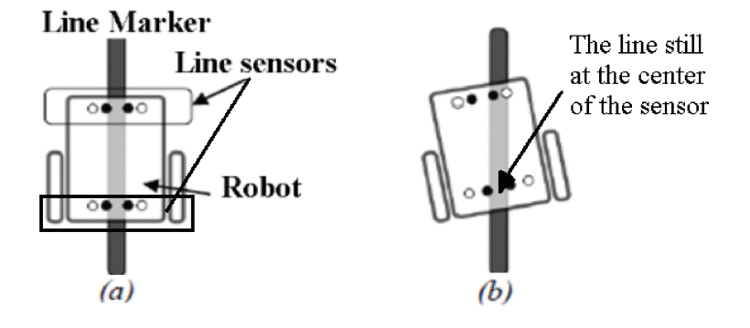
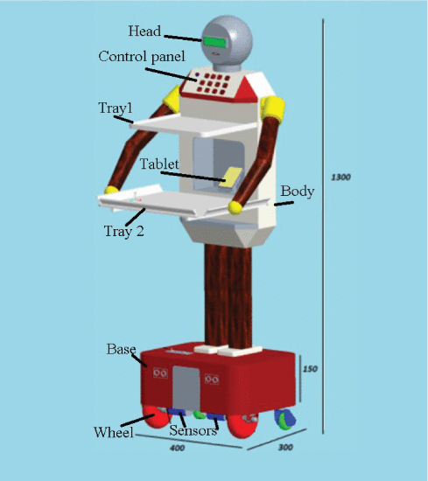
Applications in real life
Restaurant Serving Robot with Double Line Sensors Following Approach [1]
The serving robot is programmed to come to a specific table by mapping data.
Based on the line reading algorithm from two LED array line sensors implemented on microcontroller.
The robot follows the line marked on the floor to move to the desired table position and returns to the service counter after completing the task.
Figure 1 shows the trajectory of a line follower robot [1]
Restaurant Serving Robot
2019 IEEE International Conference on Mechatronics and Automation (ICMA)
Date of Conference: 04-07 August 2019.
Date Added to IEEE Xplore: 29 August 2019
INSPEC Accession Number: 18956524. DOI: 10.1109/ICMA.2019.8816404
Publisher: IEEE. Conference Location: Tianjin, China
Figure 2 shows a line follower robot [1]
Sources : [1]https://ieeexplore-ieee-org.libproxy.csun.edu/document/8816404

Slide 5
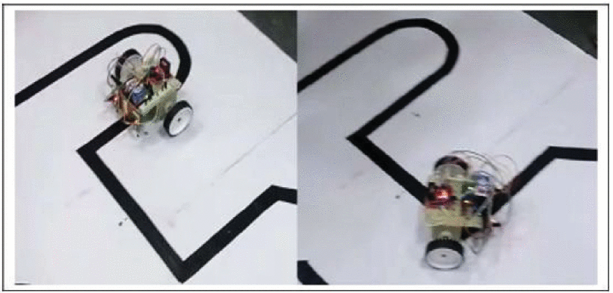
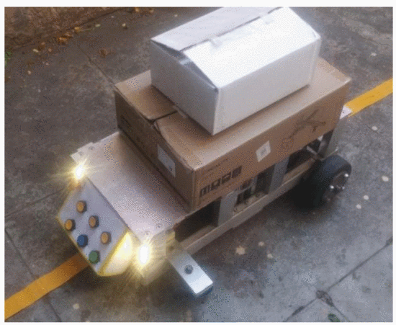
Line follower robots & their use
Line Follower Robot: Design and Hardware Application [2]
These robots may be used in various industrial and domestic applications such as to carry goods, floor cleaning, delivery services and transportation. [2]
Design and Development of Automated Guided Vehicle with Line Follower Concept [3]
During the design, basic functionalities such as line follow, drive mechanism, and path planning are highlighted. It can be used as a warehouse material handling robot, and to improve the health-care system, among other things. [3]
Figure 3 shows Movement of Line Follower Robot [2]
Figure 4 shows an Automated Guided Vehicle with Line Follower Concept [3]
[2] https://ieeexplore-ieee-org.libproxy.csun.edu/document/9197968
[3] https://ieeexplore-ieee-org.libproxy.csun.edu/document/10179618

Slide 6
How are we planning to implement our idea to the real life at CSUN campus
We will use a computational algorithm to find a path that is cost efficient and will let us travel through all CSUN walkways
Kruskal’s Minimum Spanning Tree Algorithm (MST)
Generates a minimum spanning tree for a weighted, undirected graph.
Sorts edges in increasing order based on the edge’s weight and keeps adding nodes to the tree only if the chosen edge does not form any cycle.
Picks the edge with a minimum cost at first and the edge with a maximum cost at last.
Sources: [4] https://ieeexplore-ieee-org.libproxy.csun.edu/document/7975216

Slide 7
Kruskal's Spanning Tree Algorithm [4] [5], [6], [7]
The algorithm selects an edge with the smallest weight and checks if it is a safe edge.
Safe edge is defined to be an edge that can be safely added to the minimum spanning tree without making a cycle or breaking its property of maintaining a minimum weight
If the edge (u, v) is safe, the set comprising u and the set comprising v are combined to a larger set.
If the edge is not safe, then it is rejected.
This procedure is iterated until all edges are tested.
What is a Minimum Spanning Tree
The Minimum Spanning Tree (MST) of a graph is the set of edges that connect every vertex contained in the original graph, such that the total weight of the edges in the tree is minimized. [4], [5], [6], [7]
Sources: [4] https://ieeexplore-ieee-org.libproxy.csun.edu/document/7975216

Slide 8
General applications of Kruskal's algorithms: [10], [11], [12]
Landing cables.
TV Network.
Tour Operations.
LAN Networks.
A network of pipes for drinking water or natural gas.
An electric grid.
Network for roads and Rail tracks connecting all the cities.
Sources: [10] https://ieeexplore-ieee-org.libproxy.csun.edu/document/10330890
[11] https://ieeexplore-ieee-org.libproxy.csun.edu/document/1673166
[12] https://ieeexplore-ieee-org.libproxy.csun.edu/document/7154702

Slide 9
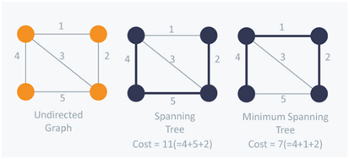
How Many Edges Does a Minimum Spanning Tree Have?
A minimum spanning tree has precisely n-1 edges, where n is the number of vertices in the graph.
n -1 = # EDGES, 4 - 1 = 3
4 VERTICES IN THIS GRAPH
n = 4
3 EDGES IN THIS GRAPH FOR THE MINIMUM SPANNING TREE
V1
V2
V1
V2
V1
V2
V3
V4
V3
V4
V3
V4
UNDIRECTED GRAPH
SPANNING TREE COST
COST = 11 = 4 + 5 + 2
MINIMUM SPANNING TREE COST
MST COST = 7 = 4 + 1 + 2
Figure 5 shows a diagram of the Kruskal algorithm
Sources: [13]Google Scholar. https://link.springer.com/chapter/10.1007/978-981-10-8968-8_10.

Slide 10
How to create a minimum spanning tree MST
Step 1: Sort all edges in increasing order of their edge weights.
Step 2: Pick the smallest edge. Can have multiple edges with the same weight
Step 3: Check if the new edge creates a cycle or loop in a spanning tree.
Step 4: If it doesn’t form the cycle, then include that edge in MST. Otherwise, discard it.
Step 5: Repeat from step 2 until it includes all edges which are all vertices minus one. | Vertices | — 1 = # edges in MST.
Sources:[13]Google Scholar. https://link.springer.com/chapter/10.1007/978-981-10-8968-8_10.

Slide 11
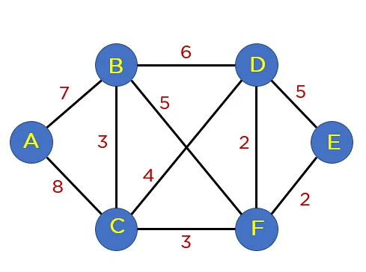
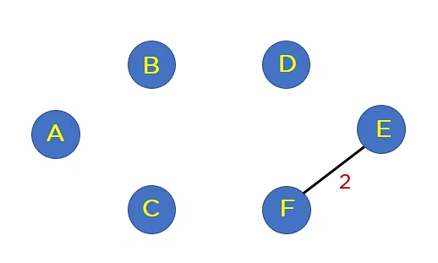
Example: Find minimum spanning tree MST using Kruskal’s algorithm
| Vertices | = 6
Edges Weight
E → F 2
F → D 2
B → C 3
C → F 3
C → D 4
B → F 5
B → D 6
A → B 7
A → C 8
Minimum Spanning Tree Edges: | Vertices | — 1 = # edges = 5 Edges
Figure 6 shows the steps of the kruskal algorithm
Sources:[13]Google Scholar. https://link.springer.com/chapter/10.1007/978-981-10-8968-8_10.

Slide 12
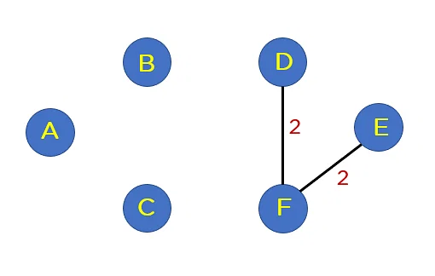
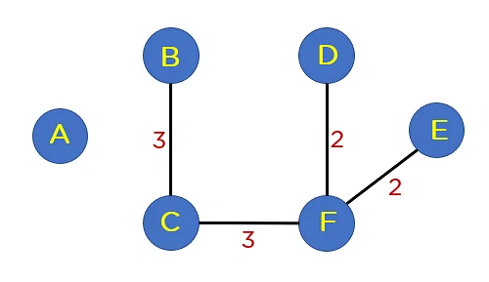
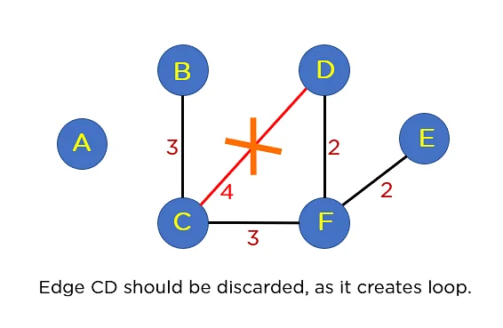
Edges Weight
E → F 2
F → D 2
B → C 3
C → F 3
C → D 4
B → F 5
B → D 6
A → B 7
A → C 8
Edge CD should be discarded, as it creates a loop.
Figure 7 shows the in-between steps of the kruskal algorithm
Sources:[13]Google Scholar. https://link.springer.com/chapter/10.1007/978-981-10-8968-8_10.

Slide 13
| Vertices | = 6
Edges Weight
E → F 2
F → D 2
B → C 3
C → F 3
C → D 4
B → F 5
B → D 6
A → B 7
A → C 8
Minimum Spanning Tree Edges
| Vertices | — 1 = # edges
5 Edges
Figure 8 shows the final steps of the kruskal algorithm
Sources:[13]Google Scholar. https://link.springer.com/chapter/10.1007/978-981-10-8968-8_10.

Slide 14
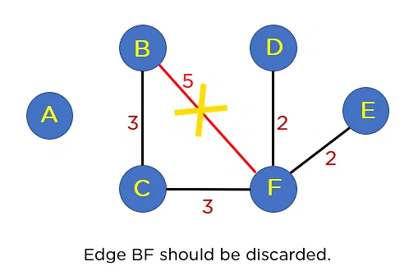
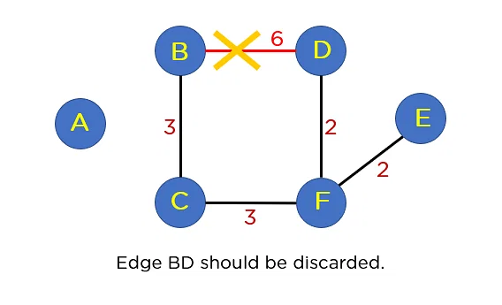
Edges Weight
E → F 2
F → D 2
B → C 3
C → F 3
C → D 4
B → F 5
B → D 6
A → B 7
A → C 8
Edge BF should be discarded.
Edge BD should be discarded.
Figure 9 shows the final steps of the kruskal algorithm
Sources:[13]Google Scholar. https://link.springer.com/chapter/10.1007/978-981-10-8968-8_10.

Slide 15
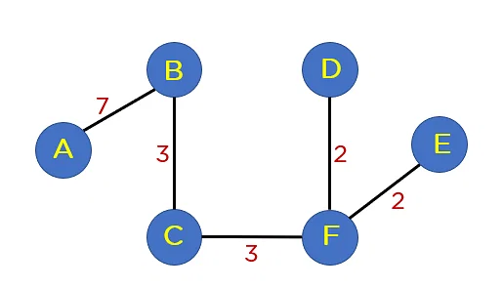
The sum of all the edge weights in MST is equal to 17, which is the least possible edge weight for any possible spanning tree structure for this particular graph.
Edges Weight
E → F 2
F → D 2
B → C 3
C → F 3
C → D 4
B → F 5
B → D 6
A → B 7
A → C 8
Minimum Spanning Tree (MST) with 5 Edges
Figure 10 shows the final steps of the kruskal algorithm
Sources:[13]Google Scholar. https://link.springer.com/chapter/10.1007/978-981-10-8968-8_10.

Slide 16
New tentative perspective of plan:
Find the lowest cost possible to mark CSUN's walkways in order to use a line follower robot.
Using Kruskal's algorithm we will find the minimal possible cost per foot length to implement this idea.
It will be possible to use a line follower robot to perform multiple tasks like:
Pick up books from the Library book drops around the campus
Transportation of different materials, waste, goods, people (drop off people to different locations and have the robot to go back by itself)
Keep CSUN campus clean
And many more tasks.

Slide 17
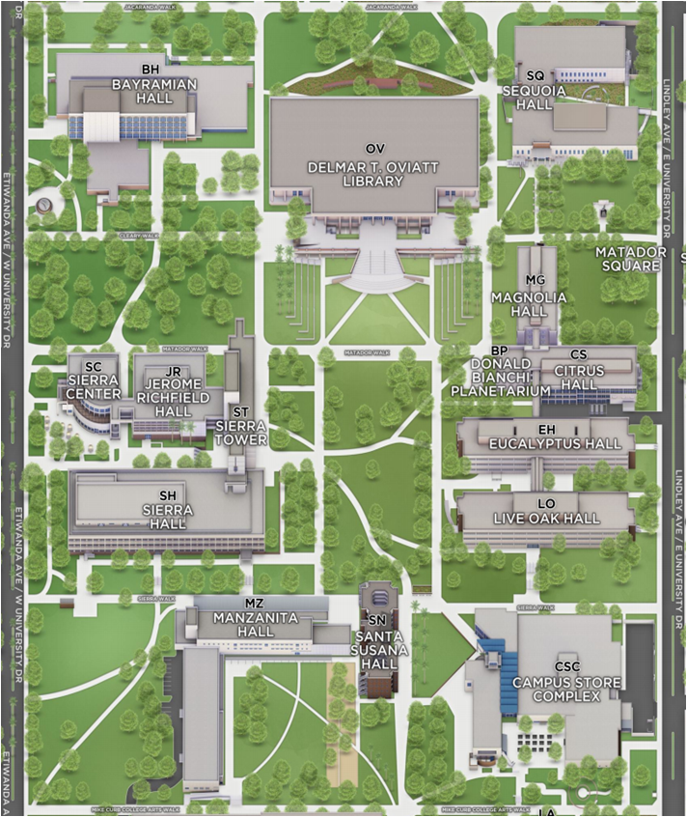
Implementation
PORTION OF CSUN MAP
[6]
Figure 11 shows a part of the CSUN campus
Source: [6]https://3dmap.csun.edu

Slide 18

Dataset Collection

Slide 19
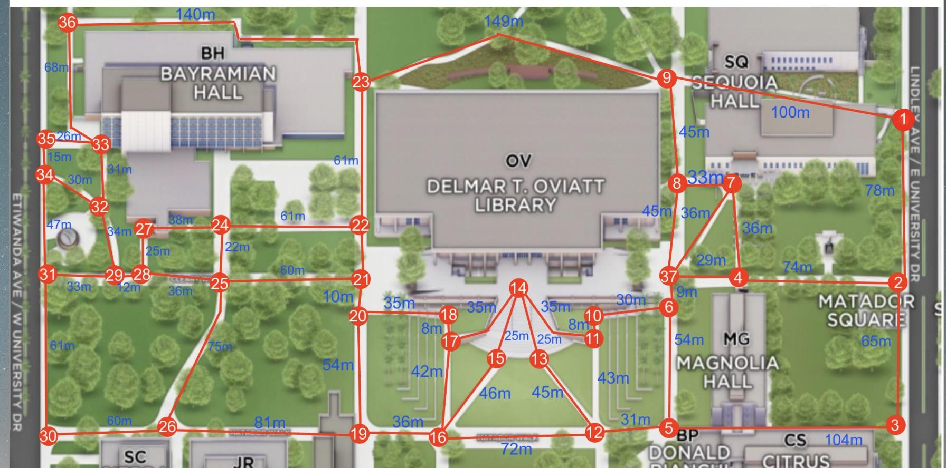
Dataset :
We collected 48 distances that connect 37 vertices in this portion of CSUN campus
Figure 12 Map of data set collected

Slide 20
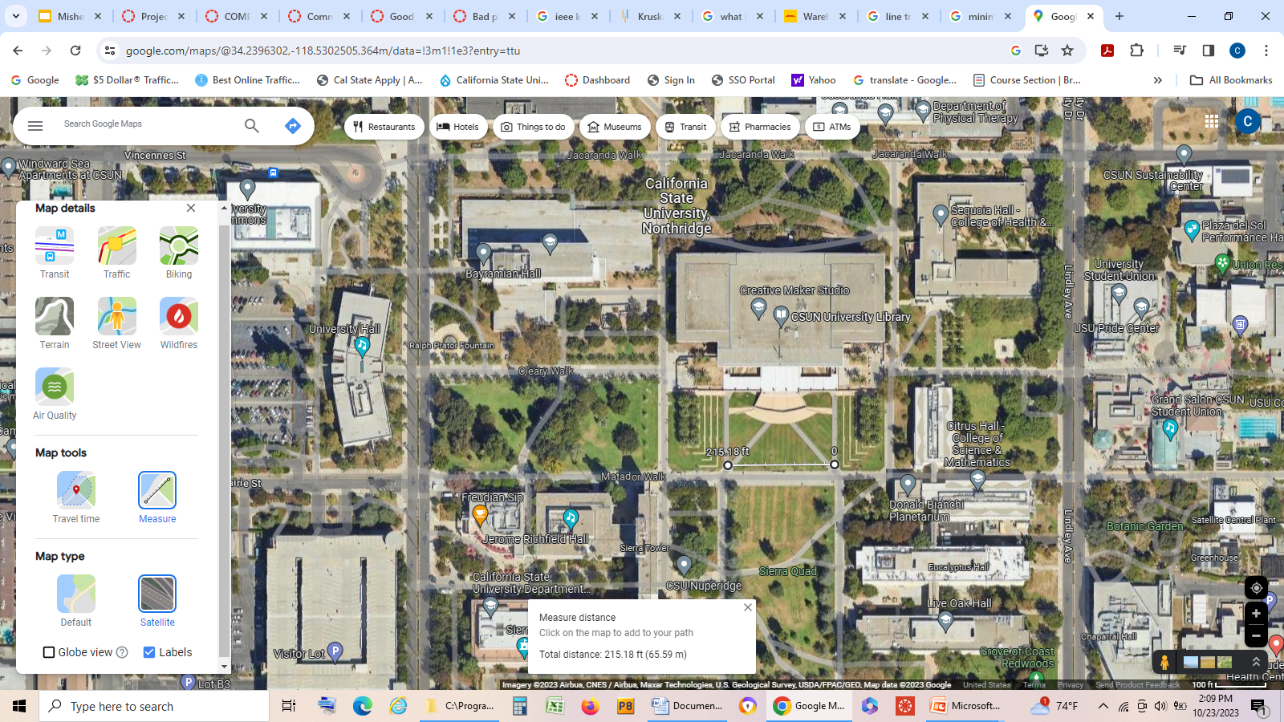

We used google maps to obtain the distance between each vertex.
Figure 13 shows distance calculated using Google maps on parts of the CSUN campus

Slide 21
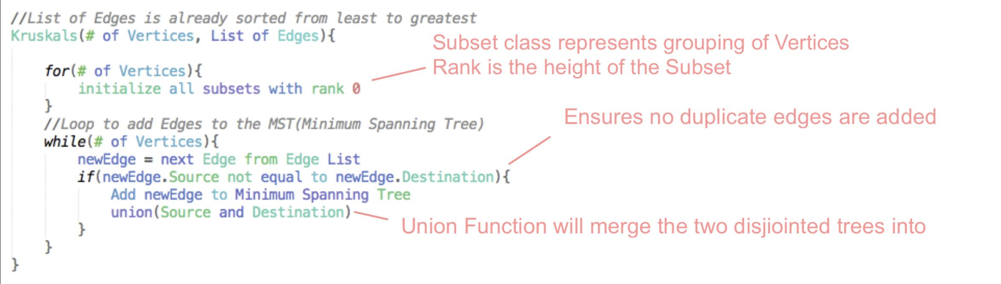
PSEUDOCODE

Slide 22
Result generated by the source code
Following are the edges of the constructed MST:
10 -- 11 == 8
17 -- 18 == 8
6 -- 37 == 9
.
.
.
22 -- 23 == 61
30 -- 31 == 61
2 -- 3 == 65
33 -- 36 == 68
2 -- 4 == 74
1 -- 2 == 78
Total cost of MST: 1301
36 edges with their weight
This is the final minimum spanning tree

Slide 23
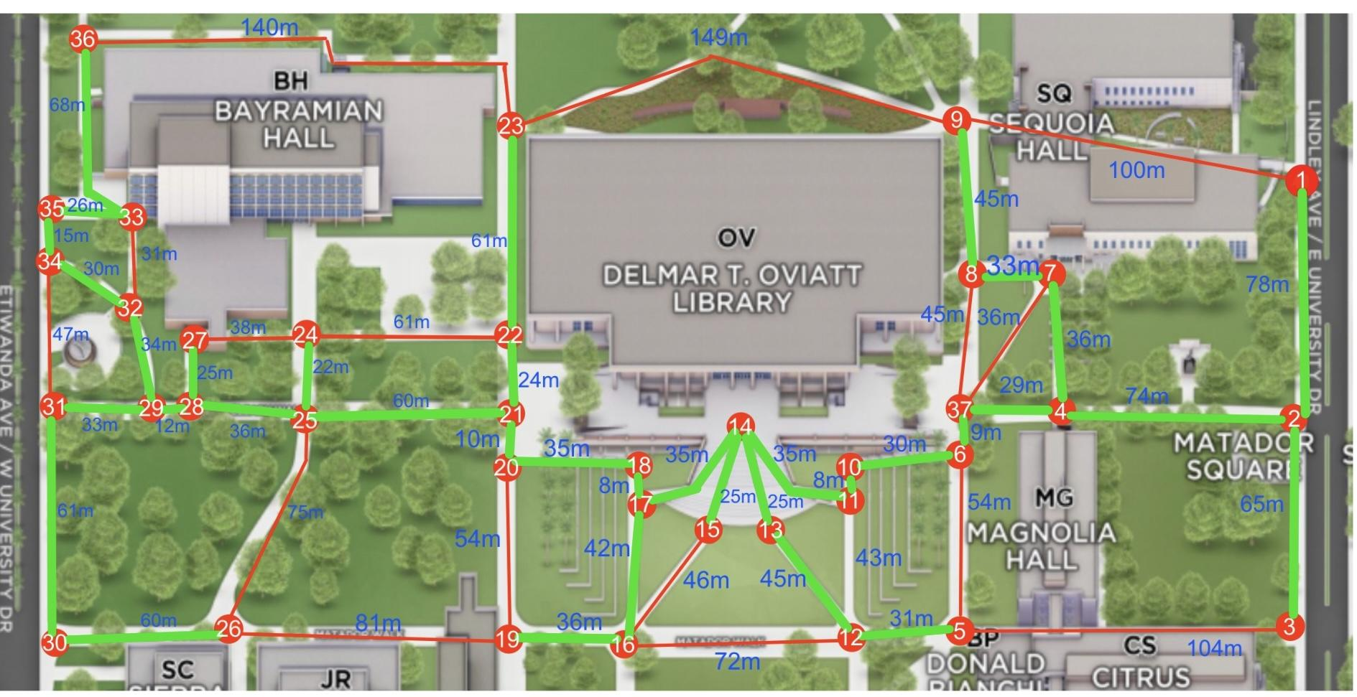
Results: Kruskal’s Minimum Spanning Tree denoted in green lines
Figure 14 Showing minimum spanning tree of the data set collected

Slide 24
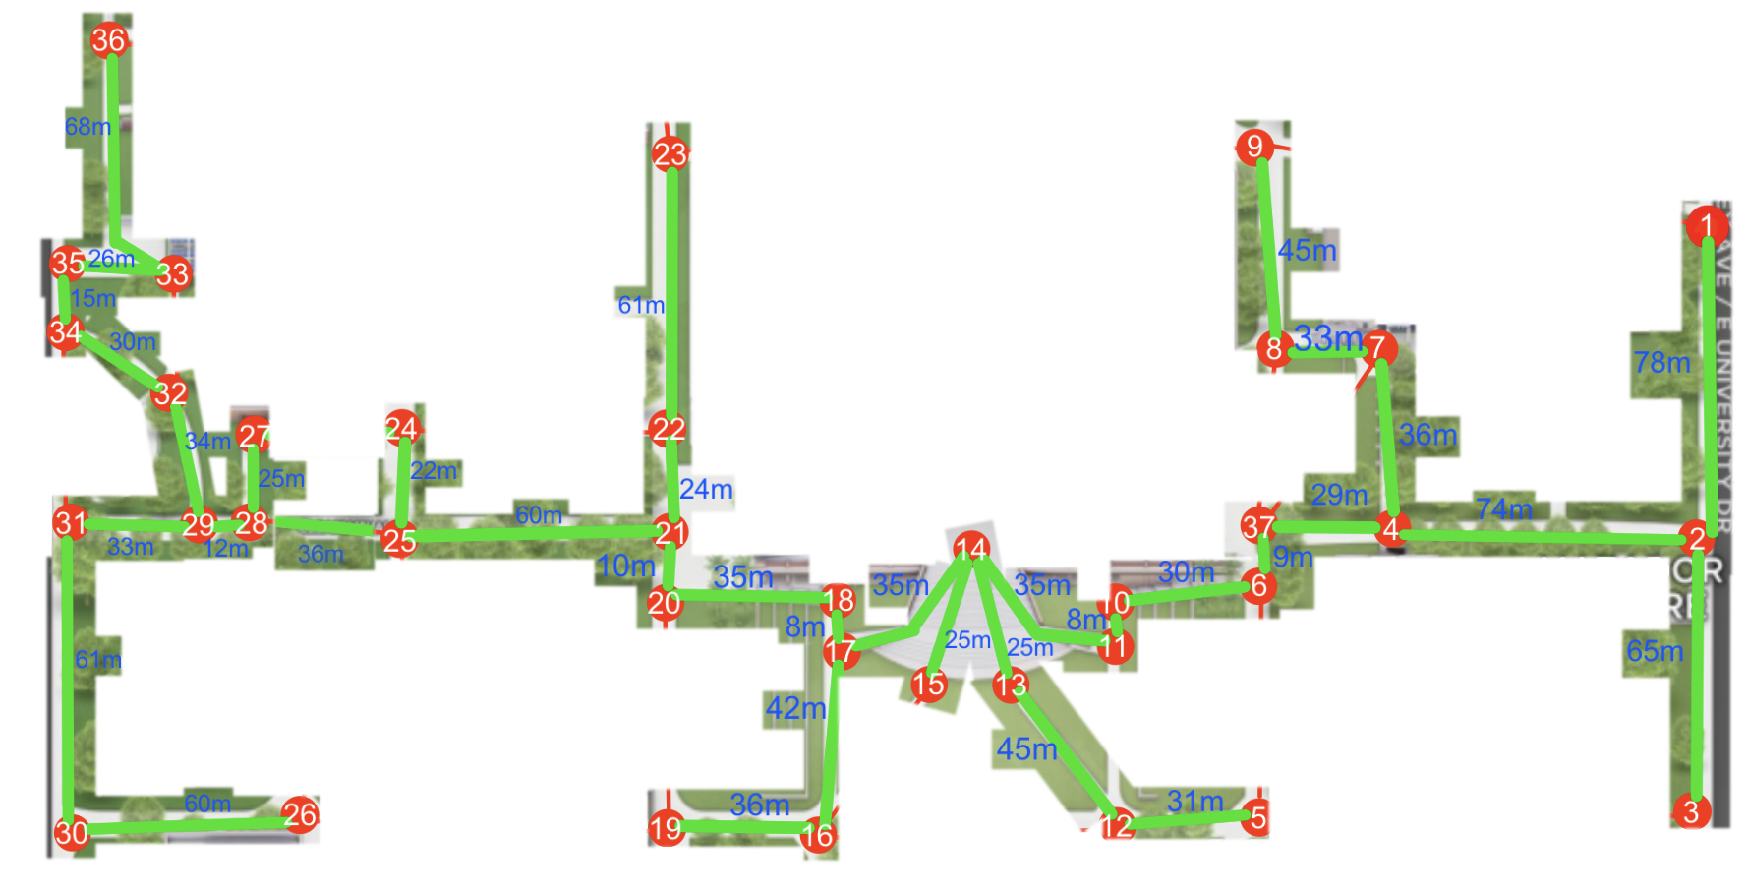
Vertices = 37 Edges 37 – 1 = 36
Final edges = 36
Minimum weight
1301 m
Figure 15 Showing minimum spanning tree of the data set collected after running Kruskal’s algorithm

Slide 25
Comparison between
Kruskal’s algorithm
& Prim’s algorithm

Slide 26
Edge Weight
1 - 2 78
2 - 3 65
2 - 4 74
12 - 5 31
37 - 6 9
4 - 7 36
7 - 8 33
8 - 9 45
6 - 10 30
10 - 11 8
13 - 12 45
14 - 13 25
11 - 14 35
14 - 15 25
17 - 16 42
14 - 17 35
17 - 18 8
16 - 19 36
18 - 20 35
20 - 21 10
21 - 22 24
22 - 23 61
25 - 24 22
21 - 25 60
Edge Weight
30 - 26 60
28 - 27 25
25 - 28 36
28 - 29 12
31 - 30 61
29 - 31 33
29 - 32 34
35 - 33 26
32 - 34 30
34 - 35 15
33 - 36 68
4 - 37 29
Data set for Prim’s algorithm same as kruskal
INITIAL GRAPH
Figure 16 Data set collected using Google maps

Slide 27
RESULTS
New Graph after applying Prim’s
Vertices = 37 Edges 37 – 1 = 36
Final edges = 36
Minimum weight
1301 m
Figure 17 Showing minimum spanning tree of the data set collected after running Prim’s algorithm

Slide 28
Comparisons and conclusions
Kruskal’s Algorithm Results:
Vertices = 37 Edges 37 – 1 = 36
Final edges = 36
Minimum weight = 1301 m
Prim’s Algorithm Results:
Vertices = 37 Edges 37 – 1 = 36
Final edges = 36
Minimum weight = 1301 m

Slide 29
Chart 1 compares both algorithms running in the same PC
Kruskal’s Algorithm Results:
Dell PC 8.00 GB RAM
Intel(R) Core(TM) 2.30GHz
Run time: 0.025 sec
Big O = O(E log V)
Prim’s Algorithm Results:
Dell PC 8.00 GB RAM
Intel(R) Core(TM) 2.30GHz
Run time: 0.053 sec
Big O = O(V²)

Slide 30
Chart 2 compares advantages & disadvantages for both algorithms
Kruskal’s Algorithm | Prim’s Algorithm
Greedy Algorithm | Greedy Algorithm
Often utilizes priority queue to select edges | Often uses a disjoint-set data structure to efficiently merge trees
Tens to be more efficient on dense graphs | Tens to be more efficient on sparse graphs

Slide 31
Contributions.
Whit this project many tasks can be done at any time of the day even during night time when the campus is free of people and the robots can move freely.
The school will save time and money to perform different activities.
Students from other science majors can make improvements to this project.
Will stimulate and promote research if it is implemented and improved.

Slide 32
Limitation and future work
Graph the entire CSUN campus in the future
Account for human traffic to estimate more accurate travel time
Expand dataset with unmarked paths to find shorter routes
Changes in terrain and obstacles might cause a static minimum spanning tree to become outdated.
Consider the line-following robot’s specific needs: avoiding steep inclines, etc.

Slide 33
References
[1] Restaurant Serving Robot with Double Line Sensors Following Approach. [Online]. Available:
https://ieeexplore-ieee-org.libproxy.csun.edu/document/8816404. [Accessed 19 Oct 2023]
[2] Line Follower Robot: Design and Hardware Application. [Online]. Available:
https://ieeexplore.ieee.org/document/9197968. [Accessed 19 Oct 2023]
[3] Design and Development of Automated Guided Vehicle with Line Follower Concept. [Online]. Available:
https://ieeexplore-ieee-org.libproxy.csun.edu/document/10179618. [Accessed 21 Oct 2023]
[4] Exploring the parallel implementations of the three classical MST algorithms. [Online]. Available:
https://ieeexplore-ieee-org.libproxy.csun.edu/document/7975216. [Accessed 21 Oct 2023]
[5] Clifford A., Shaffer. “Kruskal’s Algorithm”. A Practical Introduction to Data Structures and Algorithm Analysis. 2nd ed. 2020 New Jersey, 2018, pp. 241, 386 - 387, 390.
[6] Weiss, Mark. “Kruskal’s Algorithm”. Data Structures and Algorithm Analysis. 2nd ed. 1994 California, 1994,
pp. 312 - 314.
[7] Clifford A., Shaffer. “Kruskal’s Algorithm”. A Practical Introduction to Data Structures and Algorithm Analysis. JAVA ed. 1998 New Jersey, pp. 217 - 218, 222, 249.

Slide 34
References
[8] California State University Northridge CSUN,” 3dmap.csun.edu. [Online]. Available:
https://3dmap.csun.edu/?id=1100. Accessed 15 Oct 2023
[9] Kruskal's Minimum Spanning Tree (MST) Algorithm
[Online]. Available: https://www.geeksforgeeks.org/kruskals-minimum-spanning-tree-algorithm-greedy-algo-2/. Accessed 15 Oct 2023
[10] An Advanced Graph Embedding Framework with Node Embedding to Design Water Pipeline Networks
[Online]. Available: https://ieeexplore-ieee-org.libproxy.csun.edu/document/10330890. Accessed 15 Oct 2023
[11] Deterministic Energy Conserving Algorithms for Wireless Sensor Networks
[Online]. Available: https://ieeexplore-ieee-org.libproxy.csun.edu/document/1673166. Accessed 15 Oct 2023
[12] An algorithm for Hierarchical Chinese postman problem using minimum spanning tree approach based on 1111Kruskal's algorithm. [Online]. Available: https://ieeexplore-ieee-org.libproxy.csun.edu/document/7154702. 1111Accessed 15 Oct 2023
[13] KMST: Kruskal’s Minimum Spanning Tree Algorithm.
Google Scholar. https://link.springer.com/chapter/10.1007/978-981-10-8968-8_10. Accessed 15 Oct 2023

Slide 35
Q&A

